Slide 1
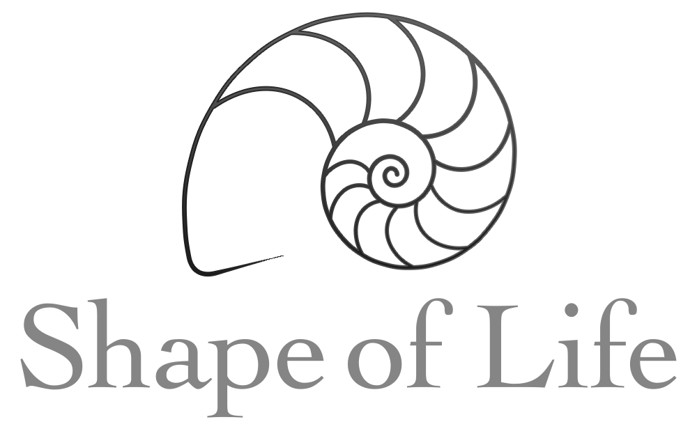
KEY
True
Land, oceans, freshwater, and inside the bodies of other animals
They are gliding efficiently and smoothly
centralized
The can sense the intensity of light and the direction from which it came.
muscles
Thousands of cilia
stereo
On the underside of its body
The pharynx extends during feeding and sucks down the prey.
True
Internal
The flatworms utilized penis fencing. Each flatworm has two penises on the underside of their body at the middle, which they use to try and stab the other flatworm. The first flatworm to stab the other delivers its sperm through the opponent’s skin.
Carrying eggs expends valuable resources

Slide 2
Hermaphrodites are animals that have both male and female sex organs.
It maximizes the chances of finding a mate to reproduce (each animal just needs to find another member of its species; not specifically a male member or a female member).
food
sex
Flatworms and modern day hunters have bilateral symmetry (efficient movement), a head with a brain, and senses in stereo.
60 feet
They use the hooks and suckers to latch into the intestinal wall, where they make more tapeworms.
sperm
eggs
Human beings on Earth

Slide 3
