Slide 1
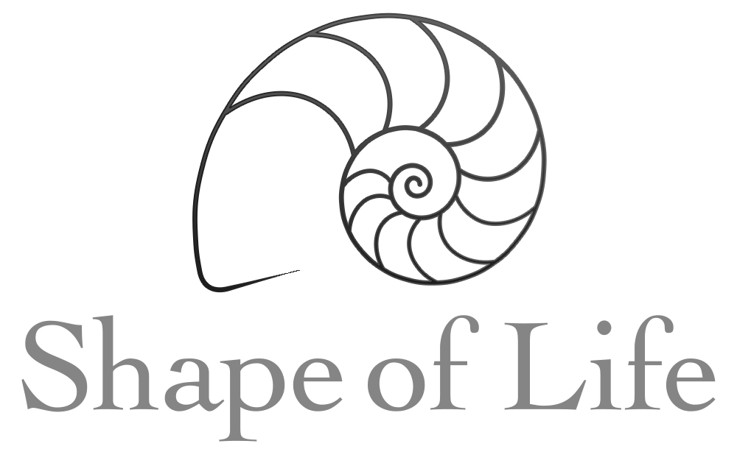
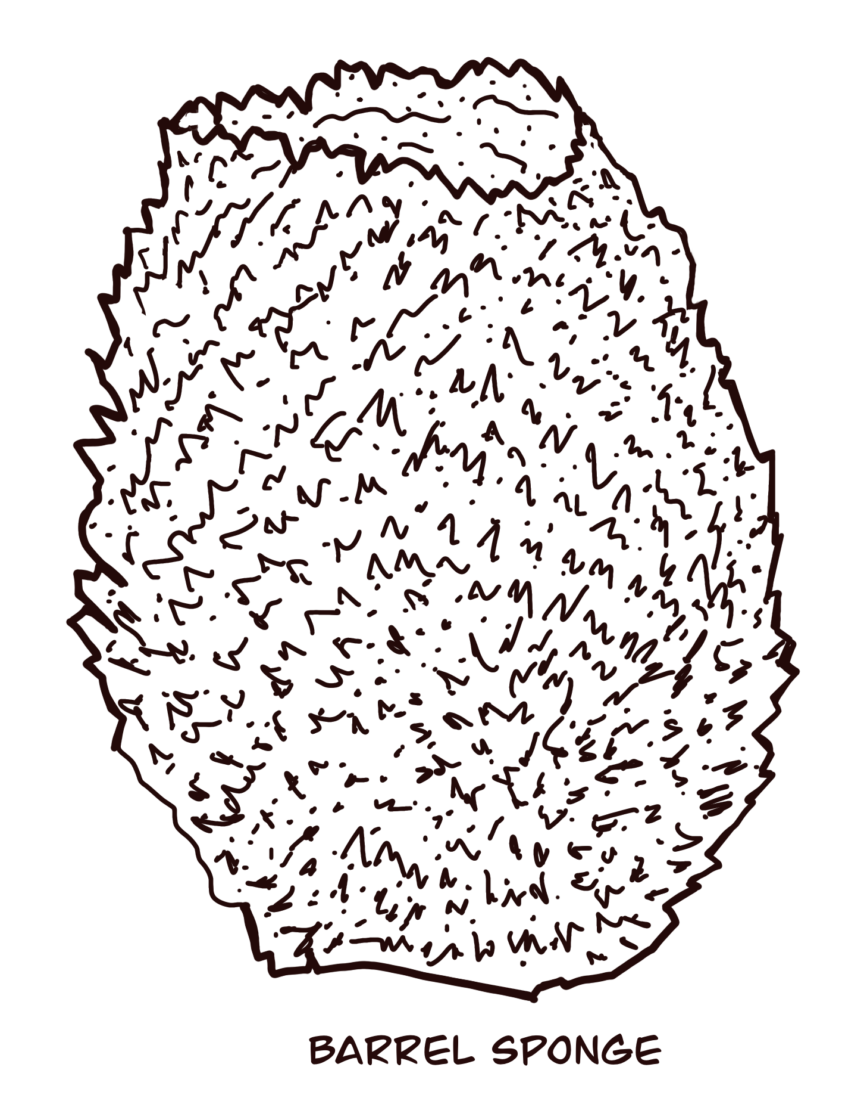
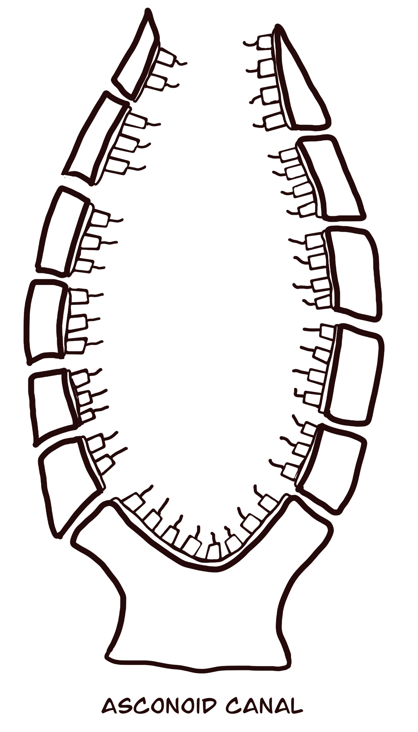
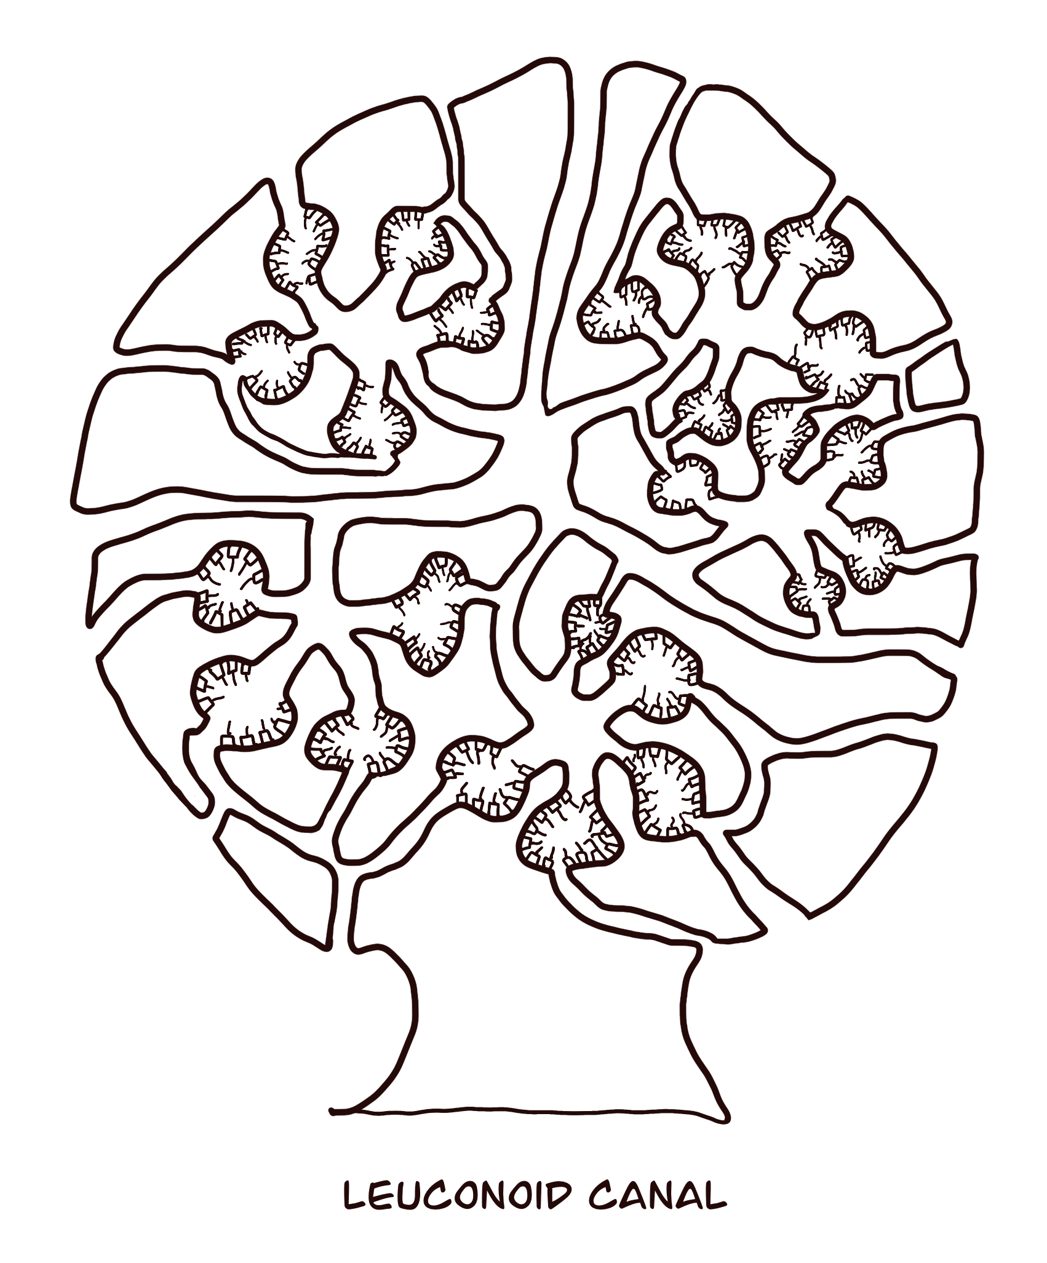
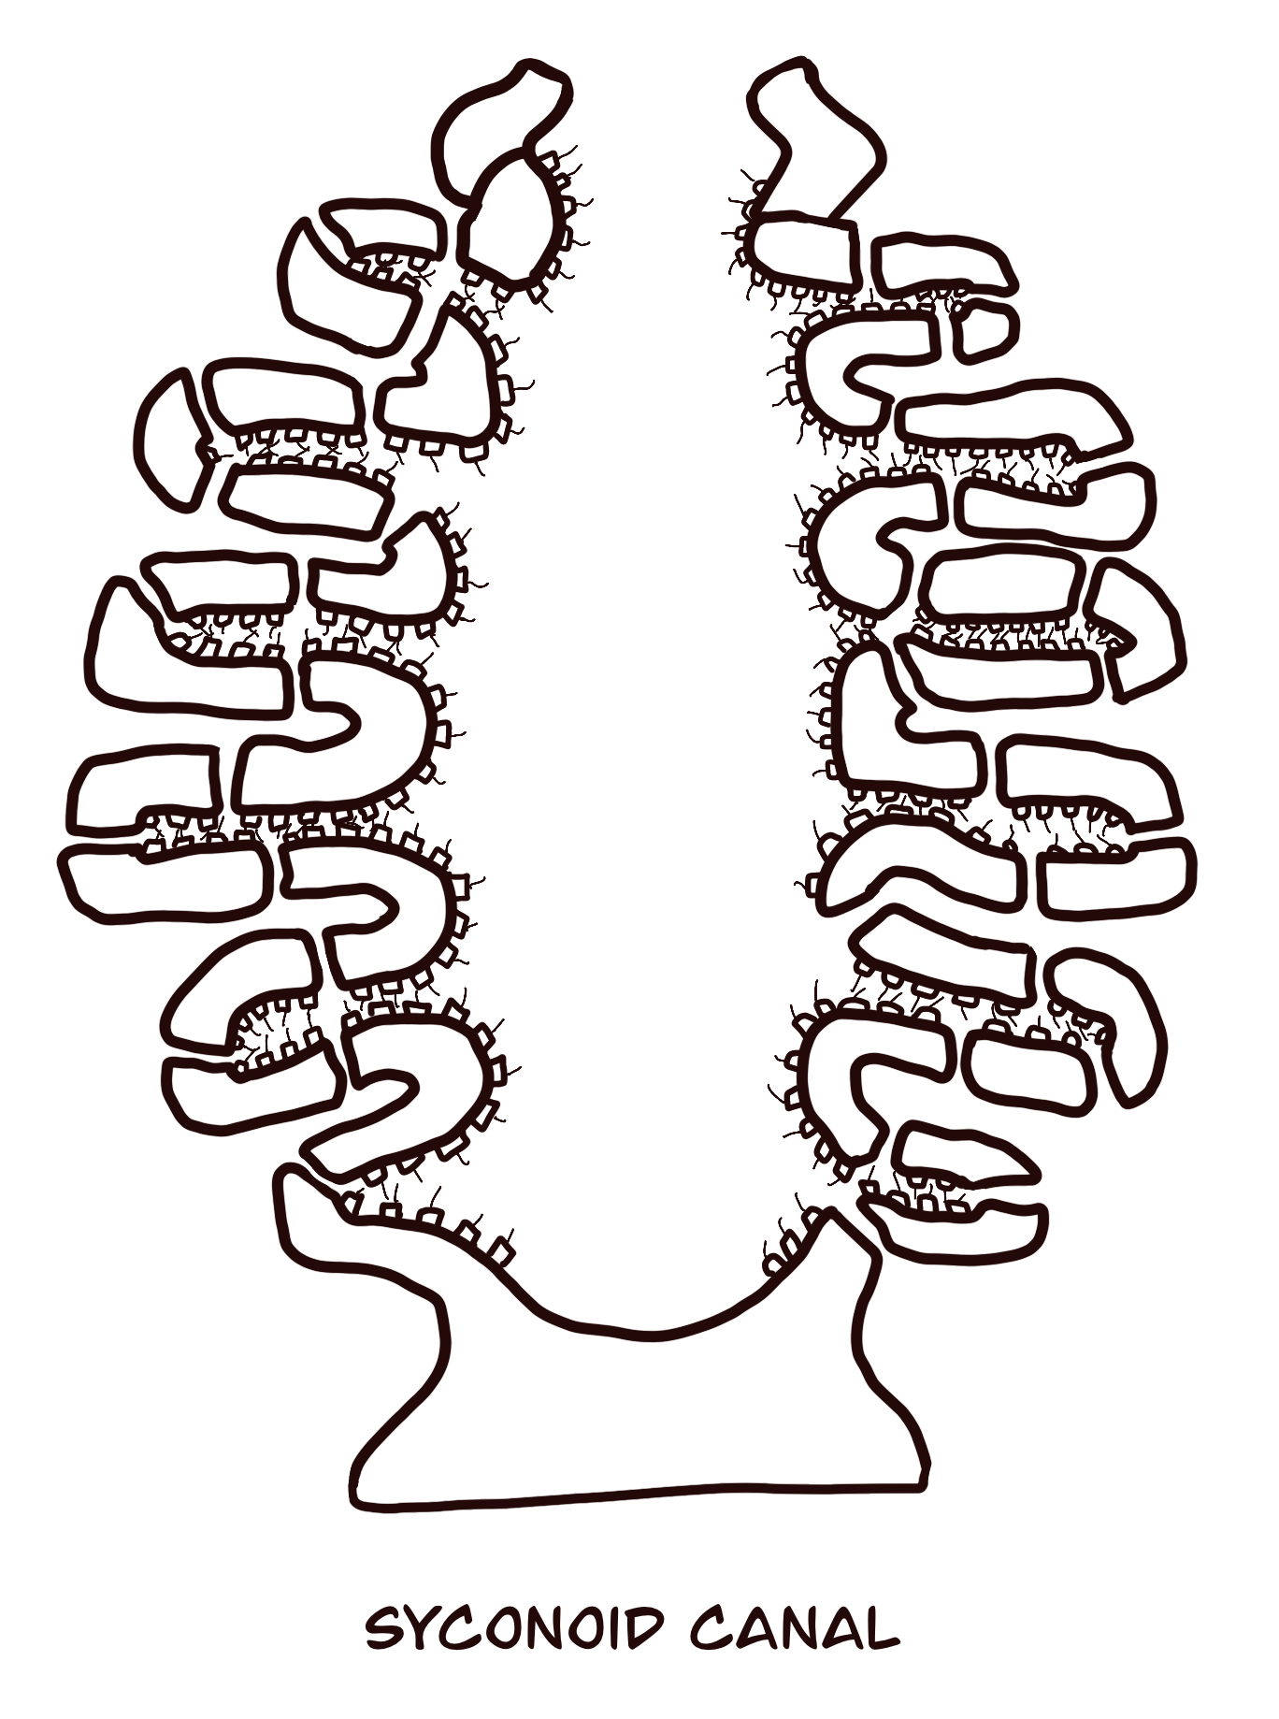
Name: ___________________________________________________________________
SHAPE OF LIFE: SPONGES
When did life on Earth first appear? _____________________________________
Describe the living things that existed before there were animals on Earth.
Are sponges ancient or relatively new organisms compared to other life on Earth?
True or False: Sponges all take the same shape. ____________________________________________
The video discusses sponges with pores (ostia), canals, and digestive cavities. Circle: which sponge canal system was described?
How many species of sponges have been discovered and described so far? ______________________
Circle the environments that a sponge can live in.
What happens if you cut a section of a sponge off?
What happens when a sponge is passed through a sieve?
What protein holds the cells of a sponge together (and is also found in all animals on Earth)?
In addition to soft collagen, what are the sharp, crystalline structures embedded in a sponge that give it rigidity and form?
In the box, sketch one of the spicules that you saw displayed in the video.
warm saltwater
cold saltwater
freshwater
on land
© Science from Scratch

Slide 2
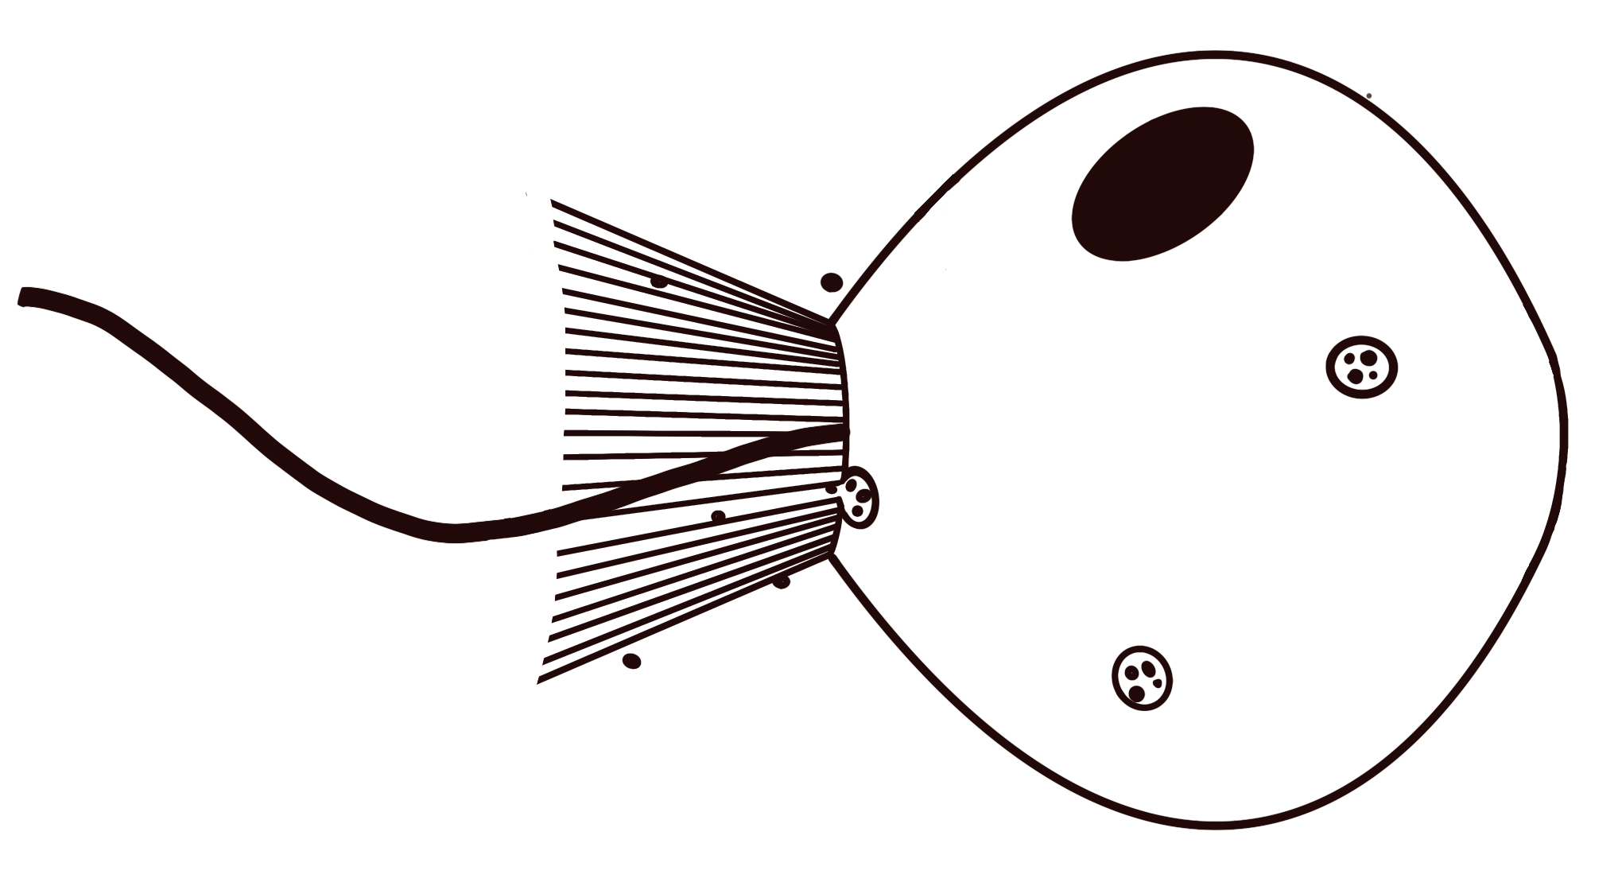
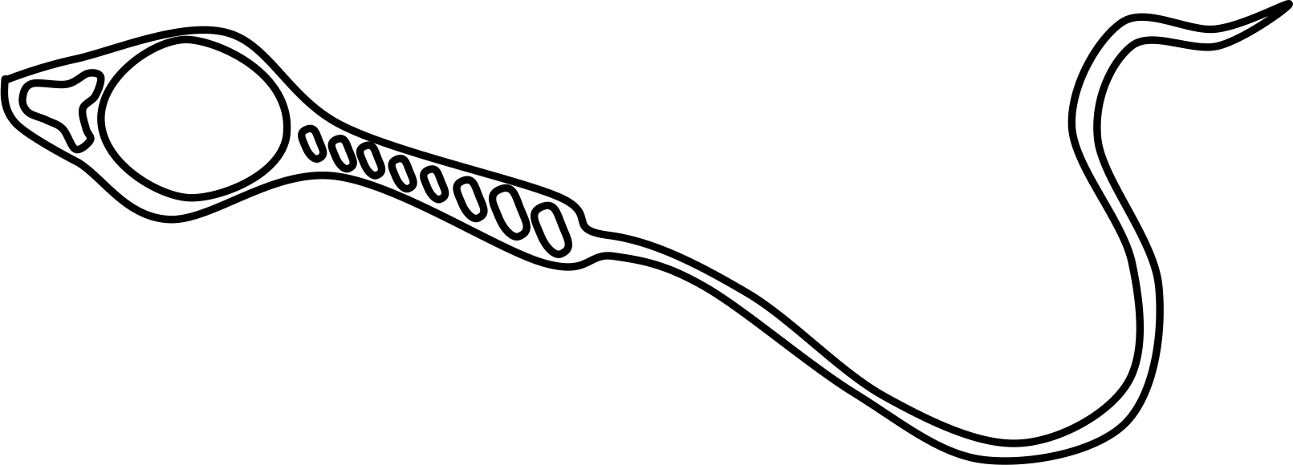
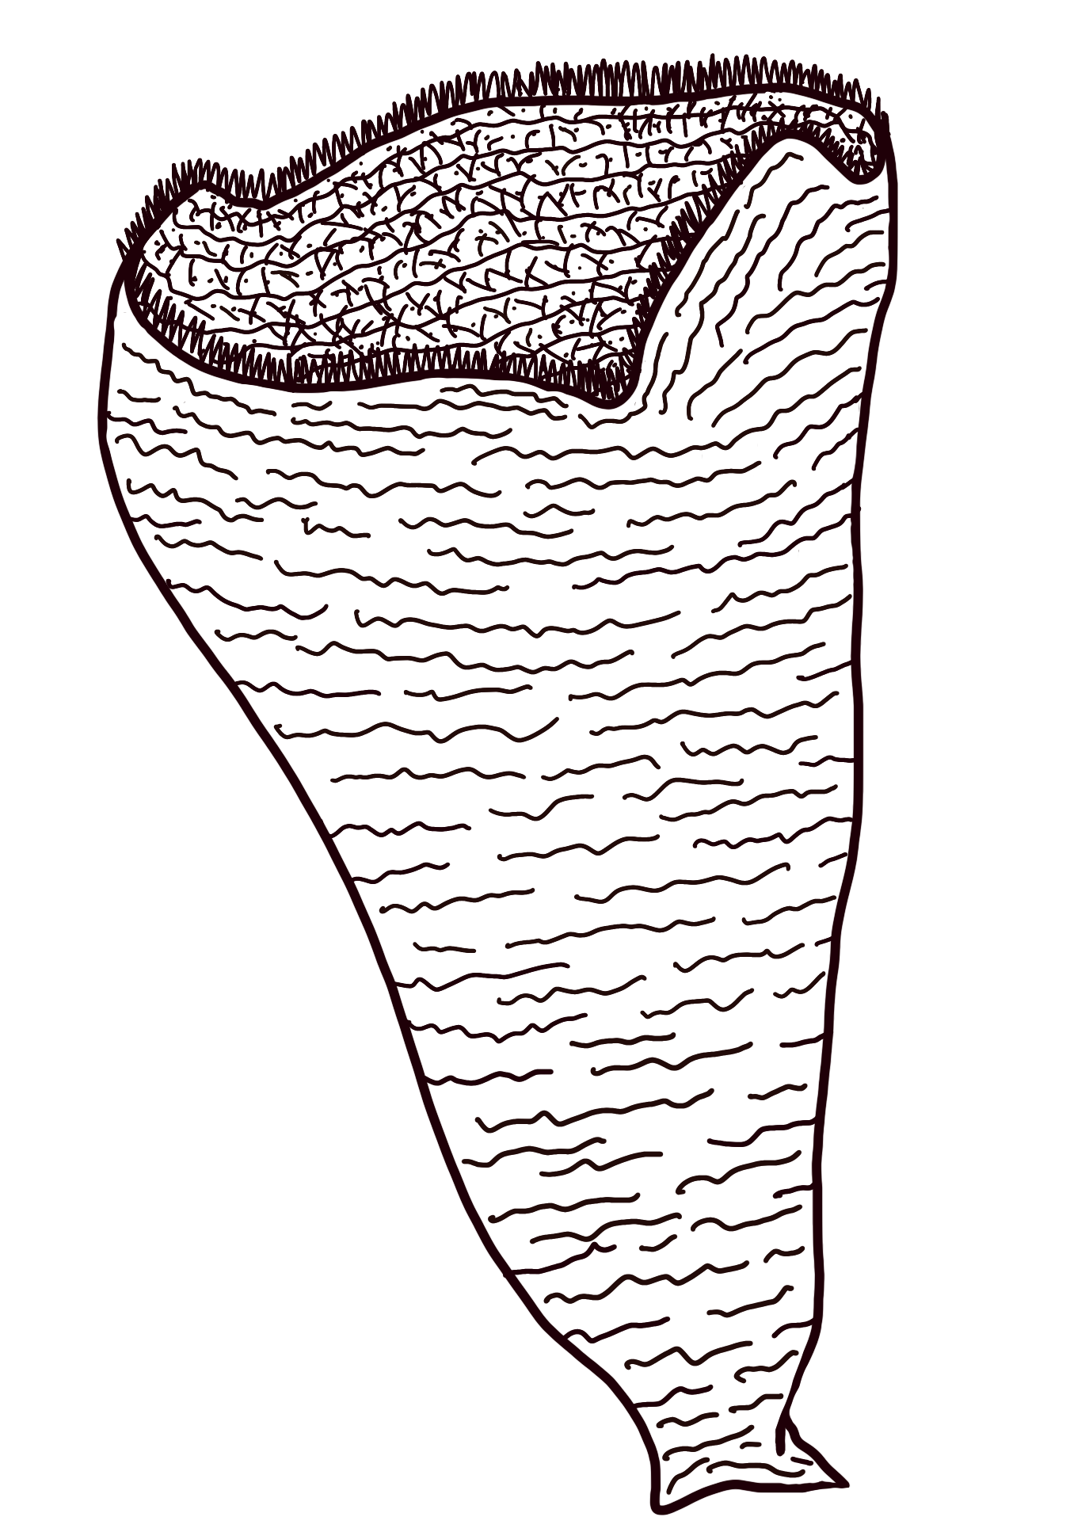
How does a sponge feed?
To get one ounce of food, how much water does a sponge have to pump? _______________________
What happened when the biologists injected colored dye into the water outside of a sponge?
If you put your hand above the osculum (large opening at the top) of a sponge, would you feel water flowing out or flowing in?
As the video takes you on a journey through the canal system of a sponge, record one interesting observation or quote.
How do choanocytes power the pumping action of a sponge?
Other than feeding, what other function does the pumping of a sponge have?
What was the first animal to reproduce using sperm and eggs? ________________________________
Do all sponge sperm successfully fertilize the egg of another sponge? Why or why not?
Conclusion Question: What are two pieces of evidence that you observed in the video that support the classification of sponges as animals?
Conclusion Question: Why would life on land be impossible for a sponge?
© Science from Scratch

Slide 3
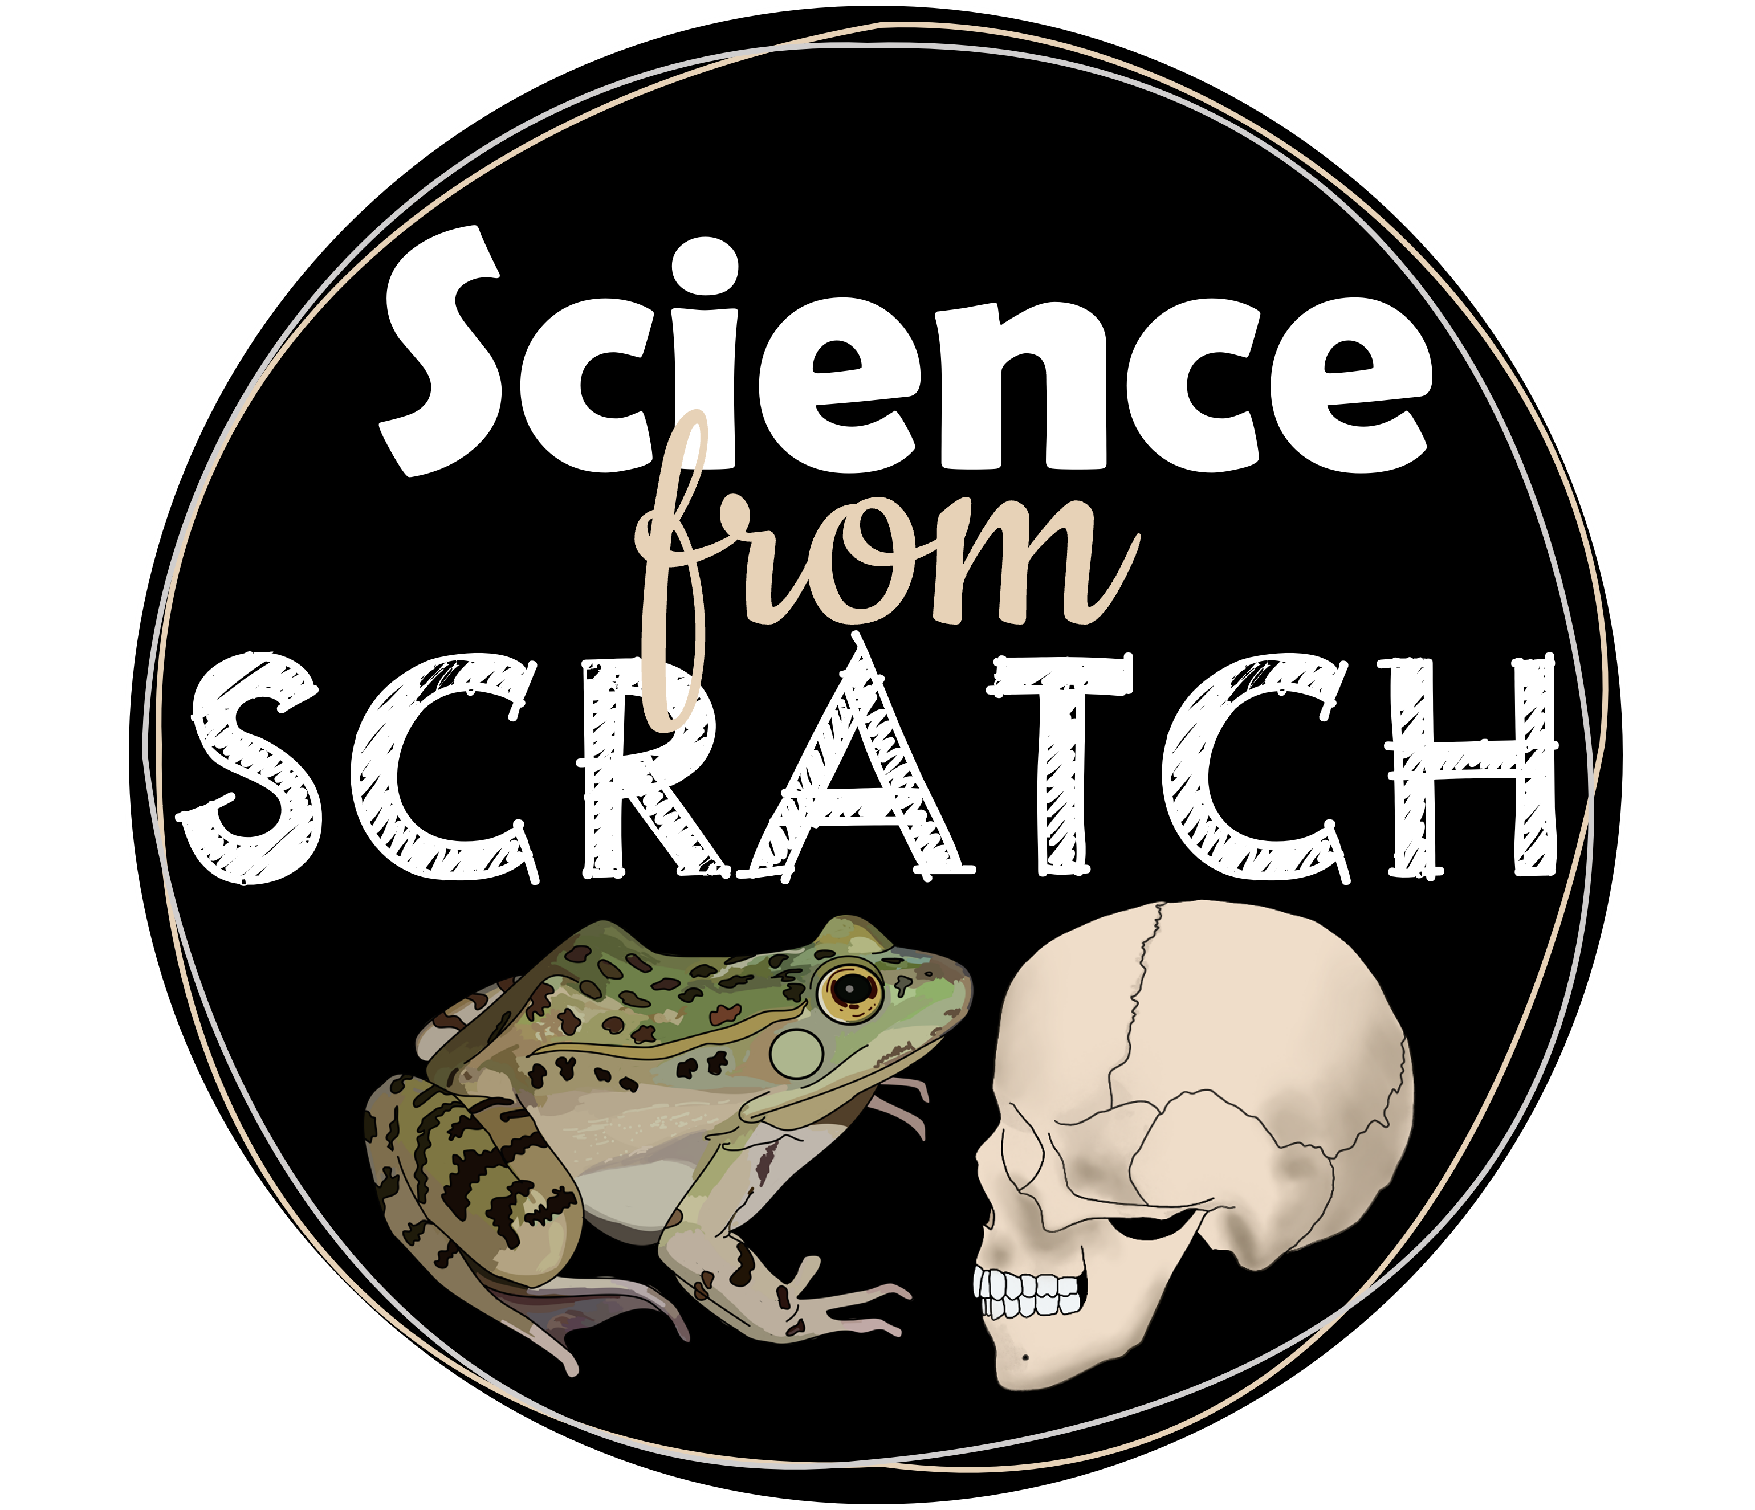
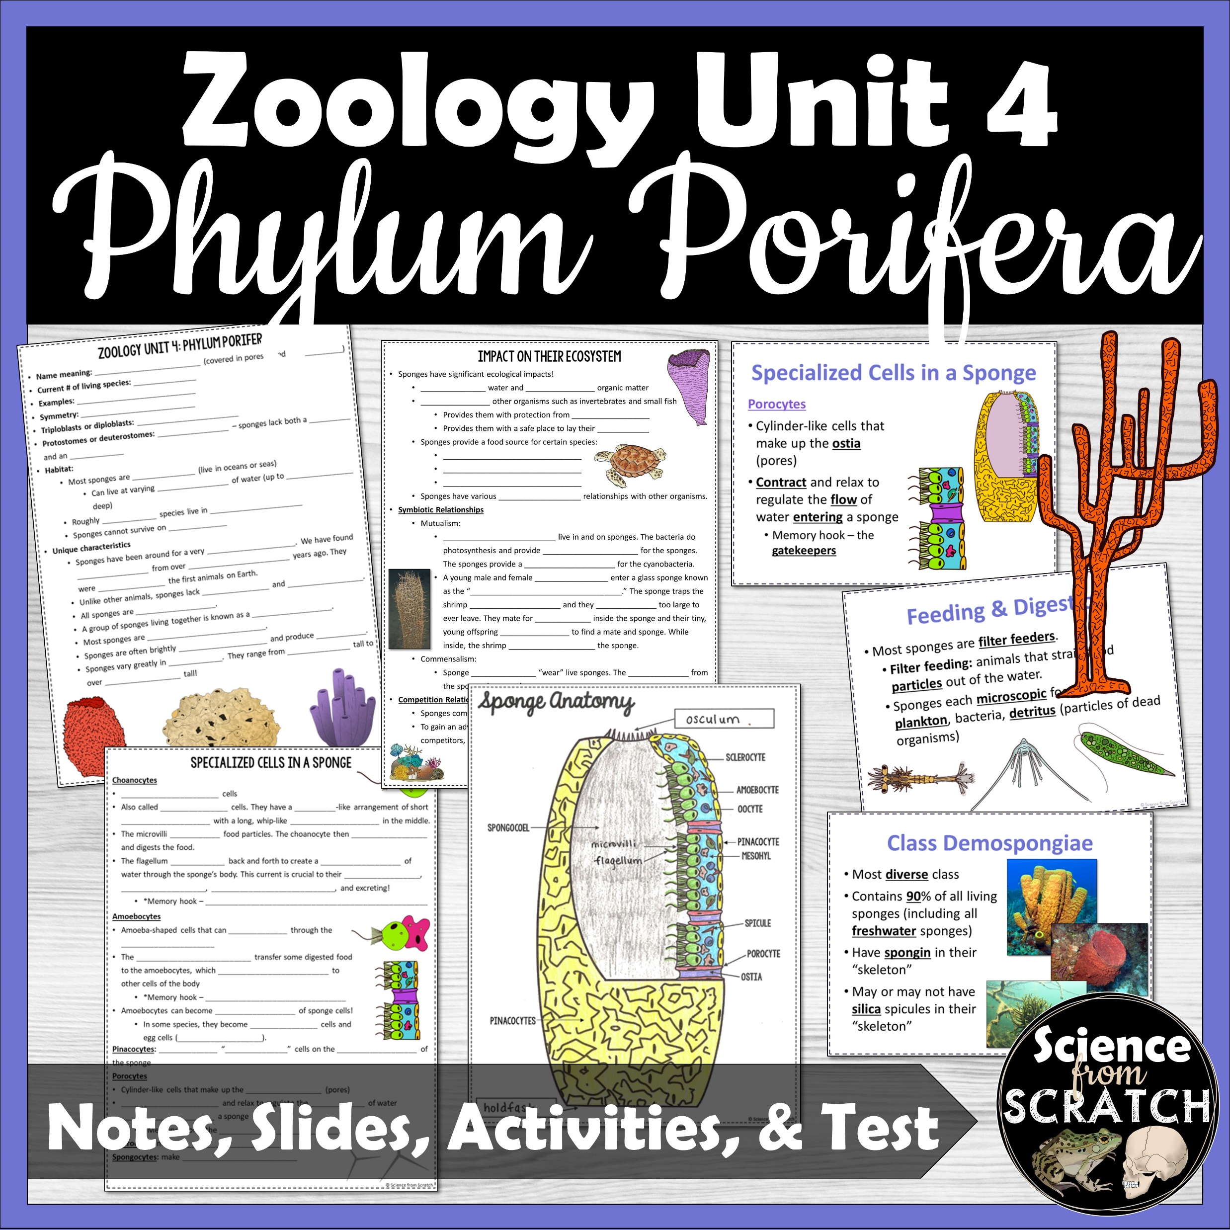
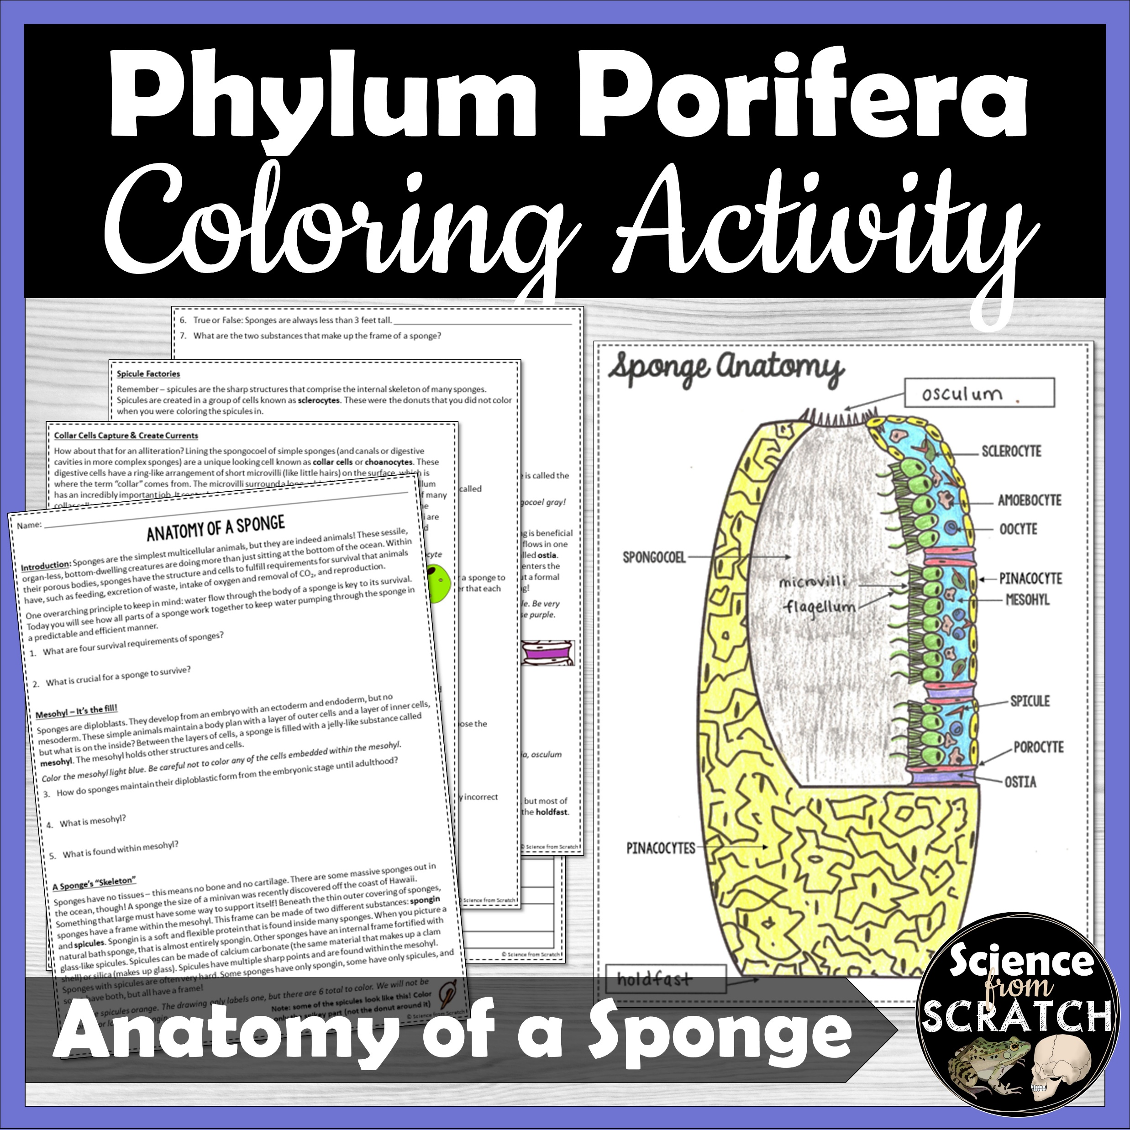
THIS PRODUCT WAS MADE BY…
This resource is the copyrighted property of Rachel Miller. YOU ARE LICENSED TO USE THIS RESOURCE IN YOUR OWN CLASSROOM AS A SINGLE-USER ONLY.
You may…
Use and make copies of this resource with your own classroom students.
Share files with your students on a private, password protected website (ex. Google Classroom or Canvas).
Share the link to this resource on Shape of Life with another teacher or on a public page.
You may not…
Share any parts of files or files on a public website, such as a school website or Facebook group. All access should occur through Shape of Life.
Claim this work as your own or create a derivative version of this work.
Sell any files or combination of files. This resource is not for commercial use.
THANK YOU FOR PROTECTING THE HARD WORK THAT WENT INTO CREATING THIS RESOURCE!
LOOKING FOR MORE ZOOLOGY RESOURCES?
Many thanks to the amazing artists whose work is incorporated into this resource:
And special thanks to…

