Slide 1
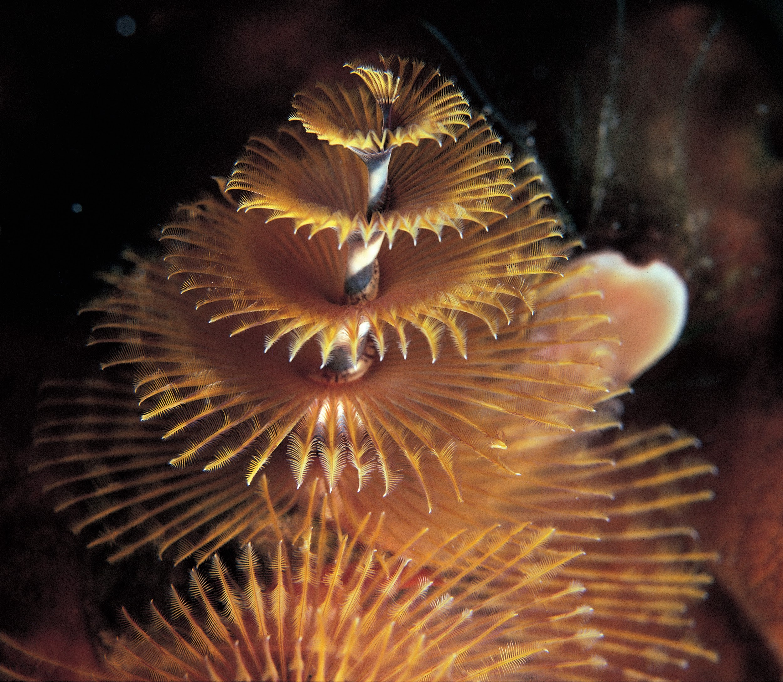
Annelids: Powerful and Capable Worms

Slide 2
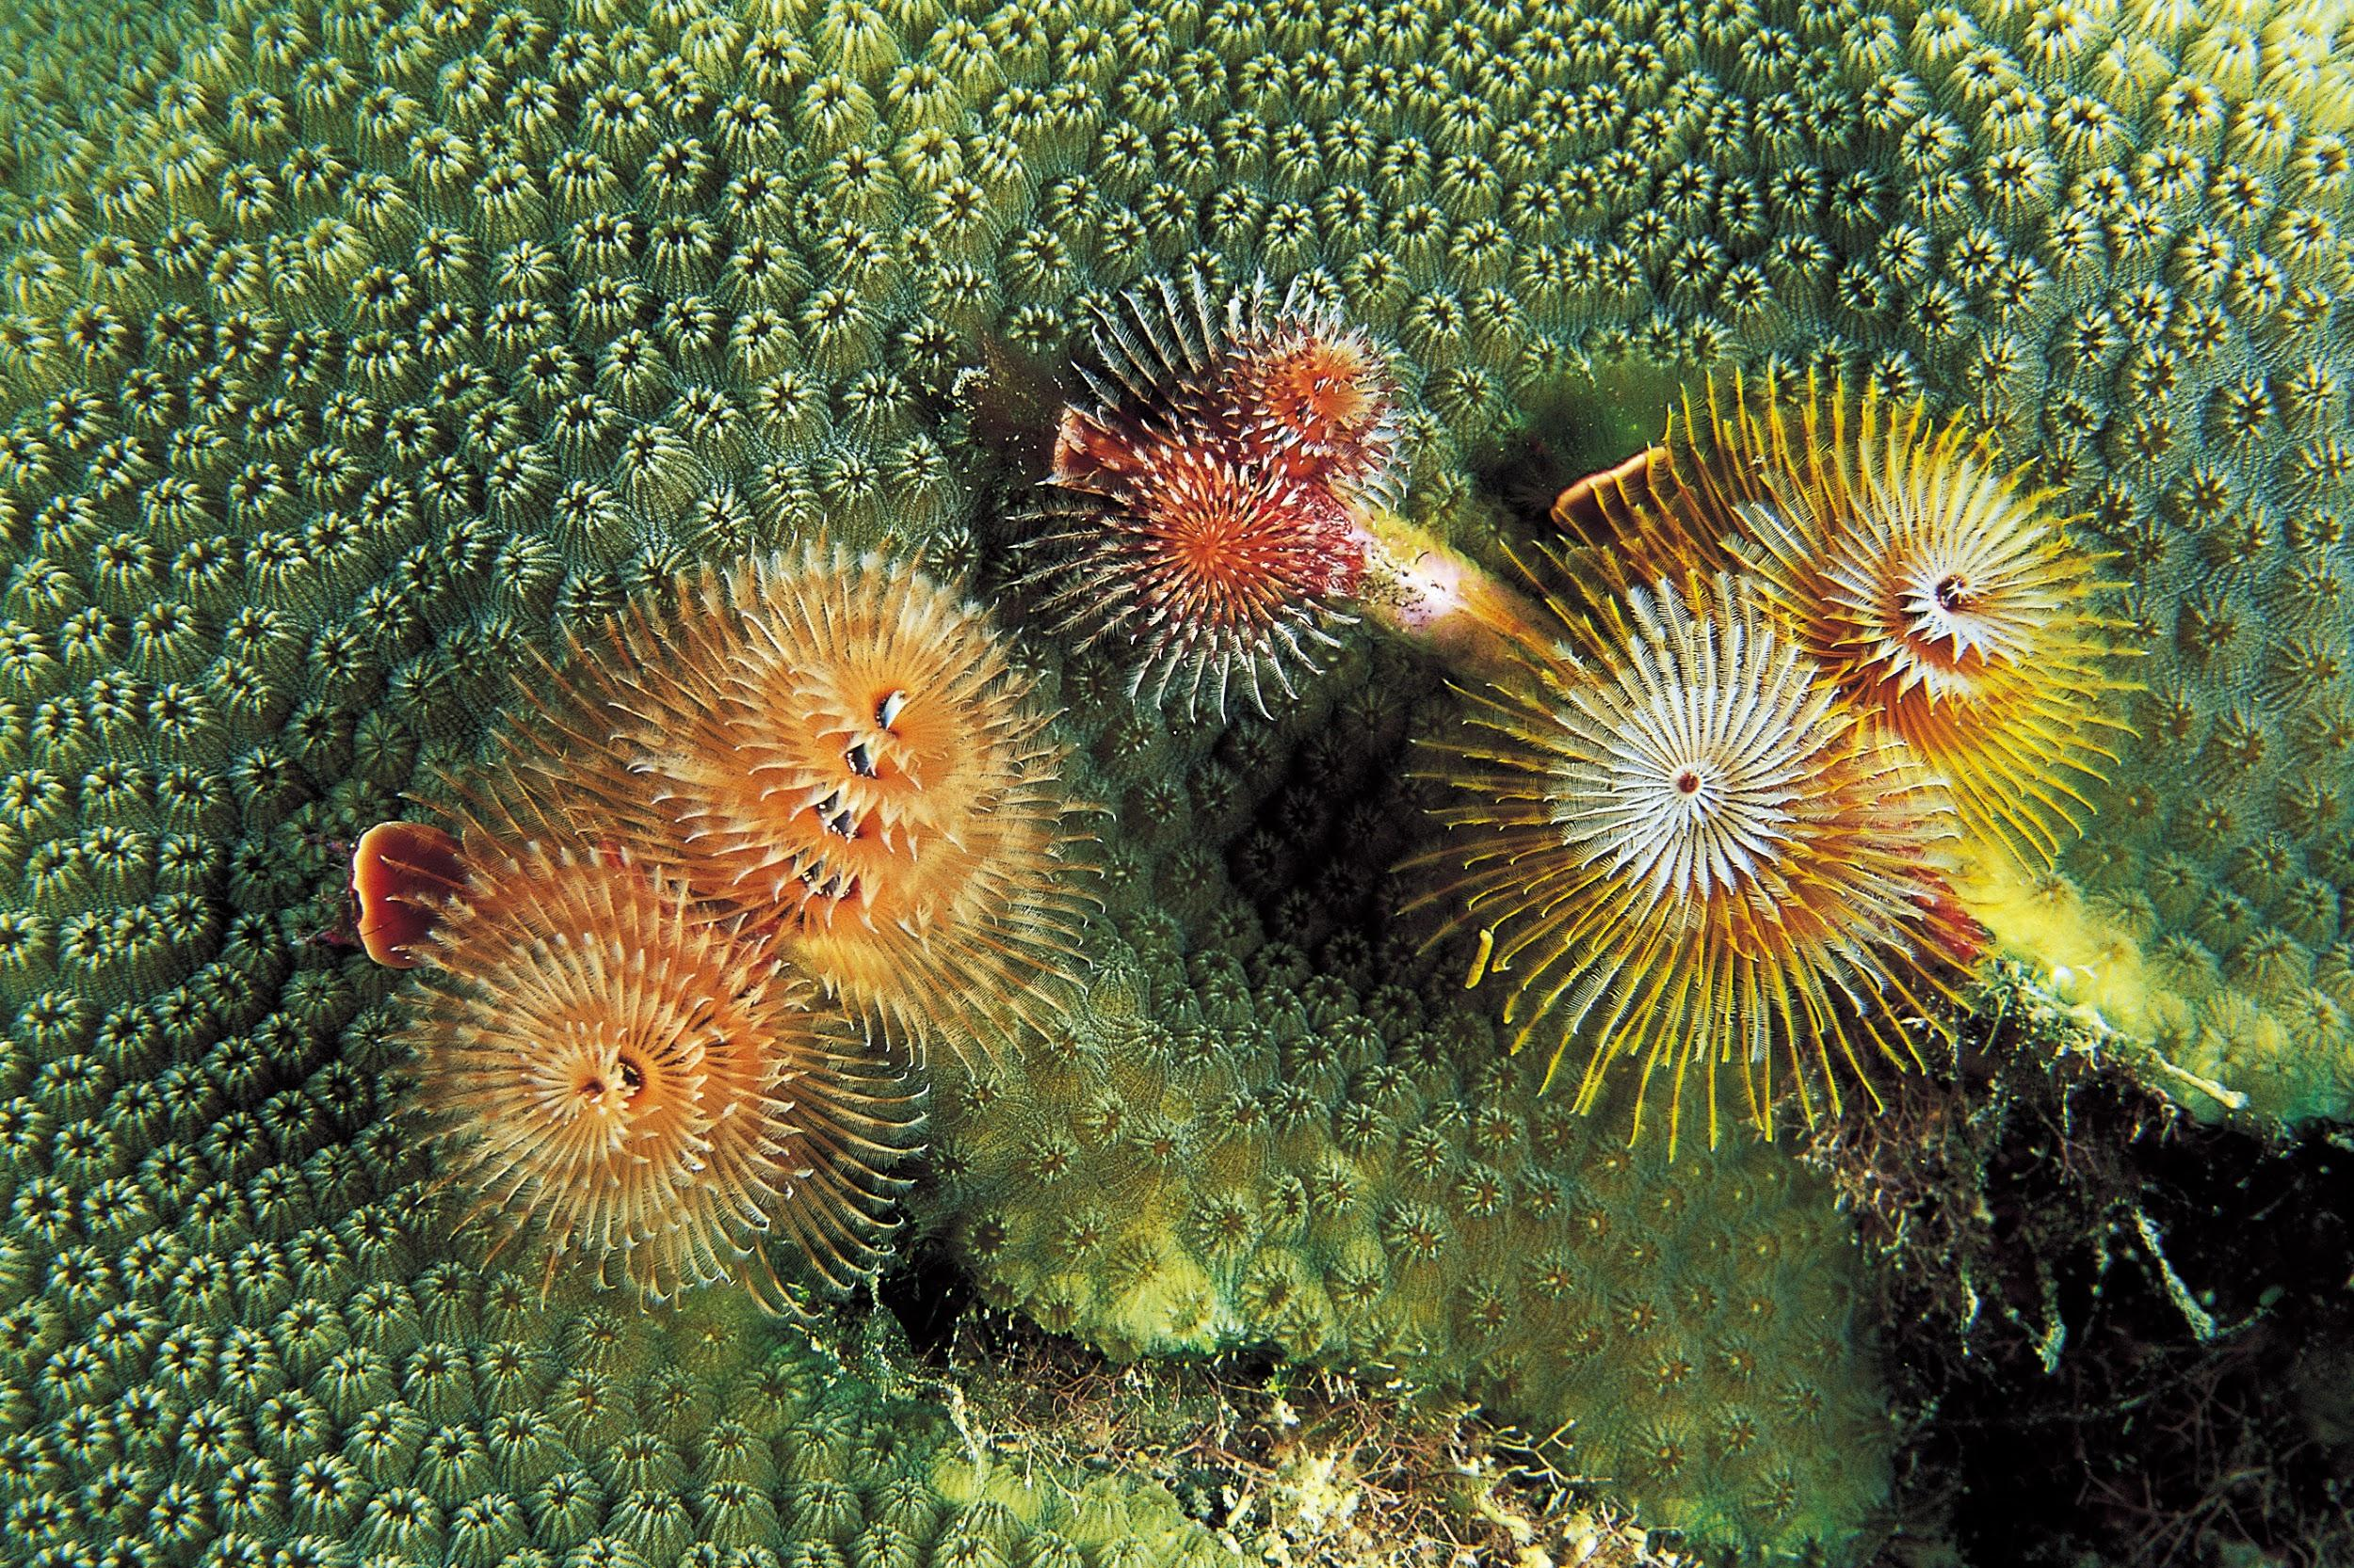
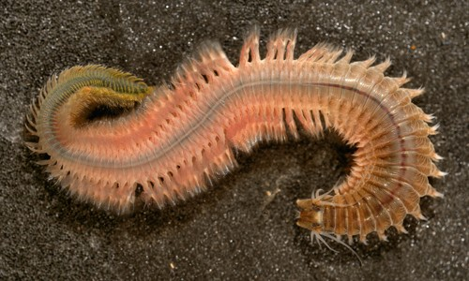
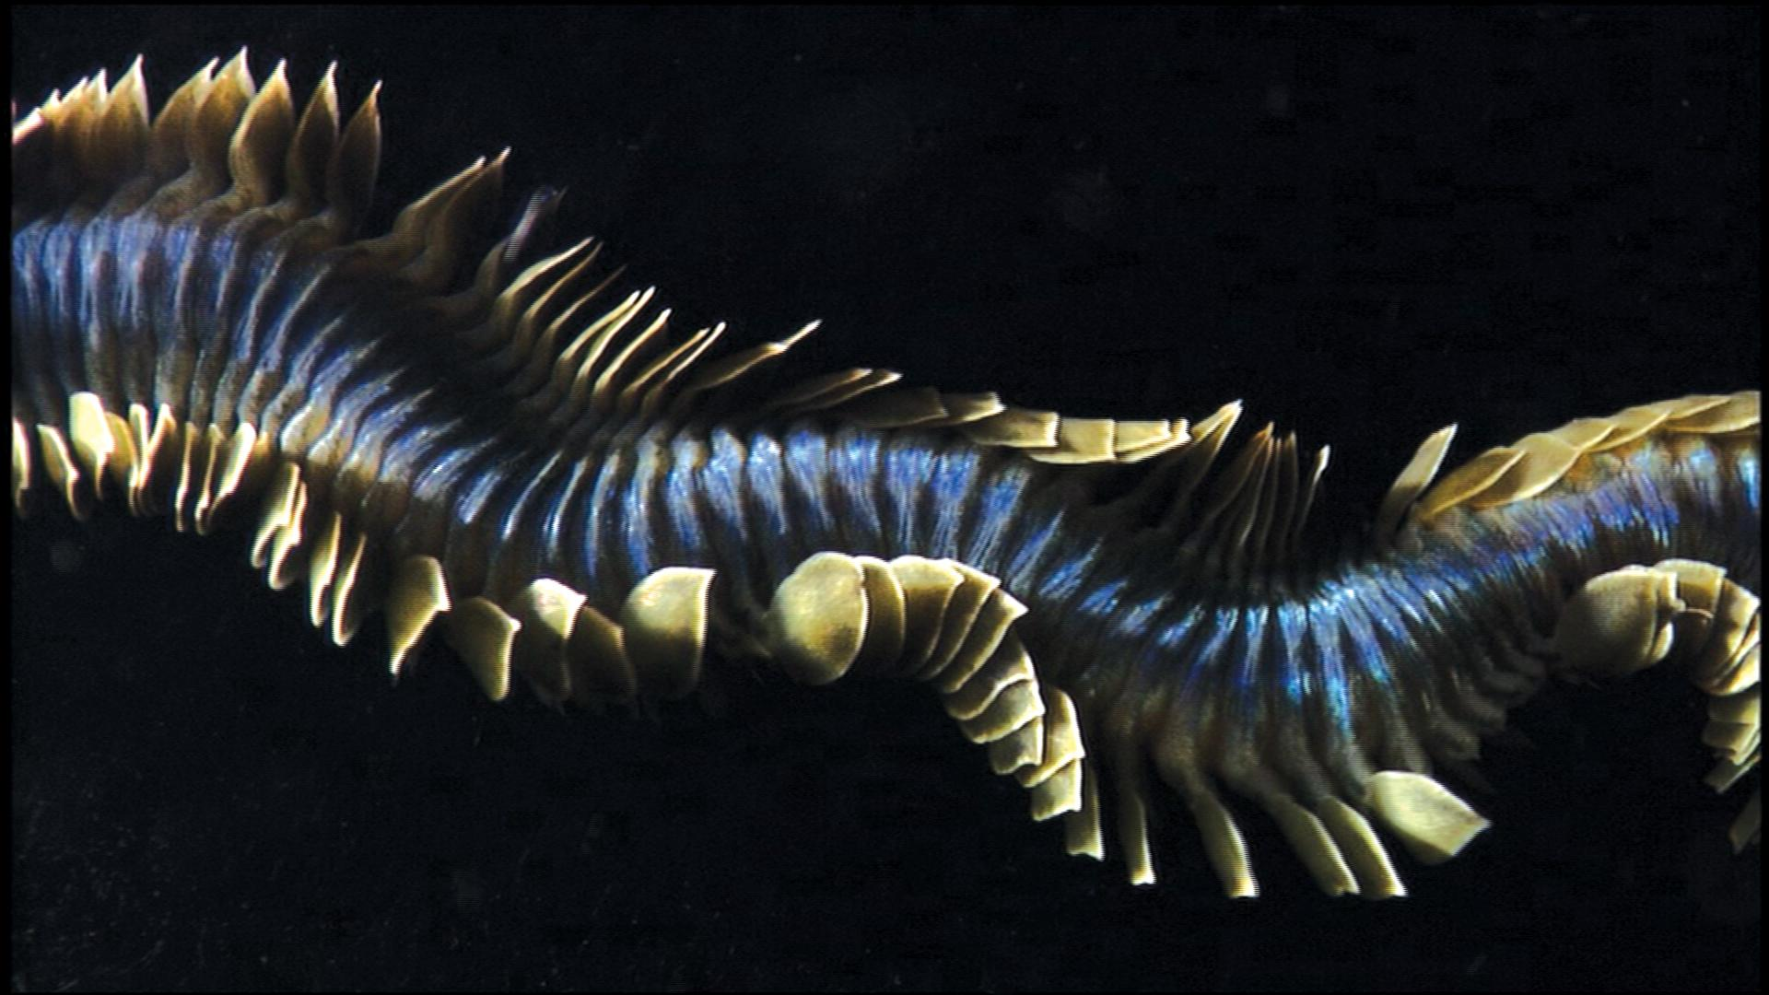
These Are All Annelids

Slide 3
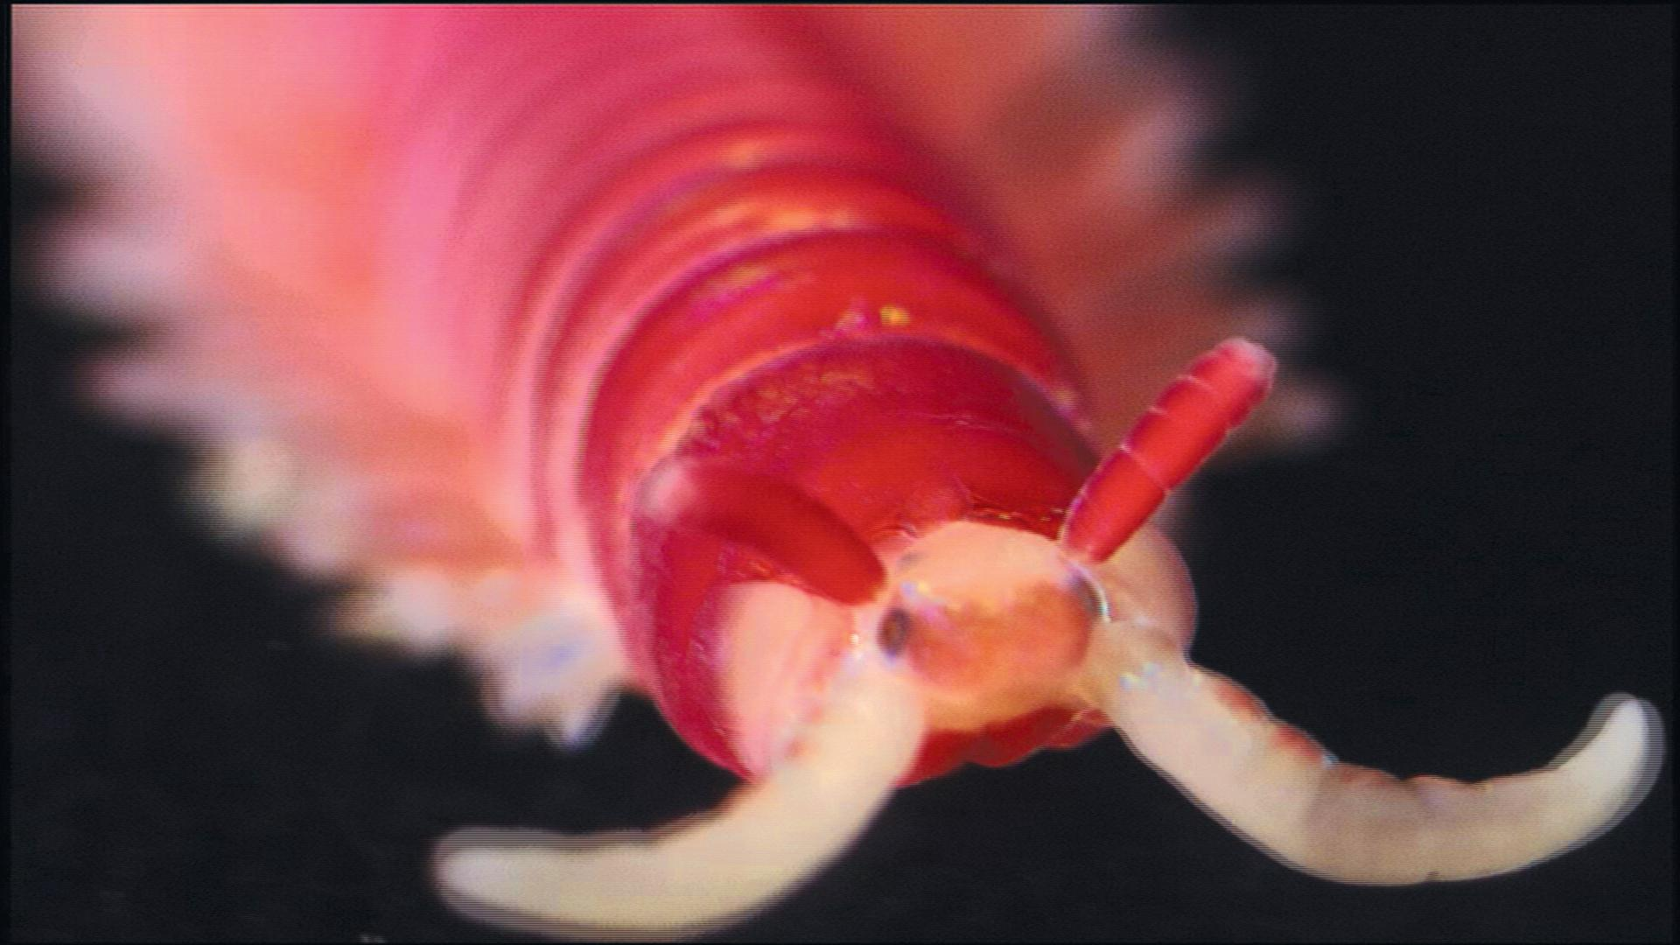
Watch Annelids: Powerful and Capable Worms. Take Notes And Answer the Following Questions
Watch this video

Slide 4
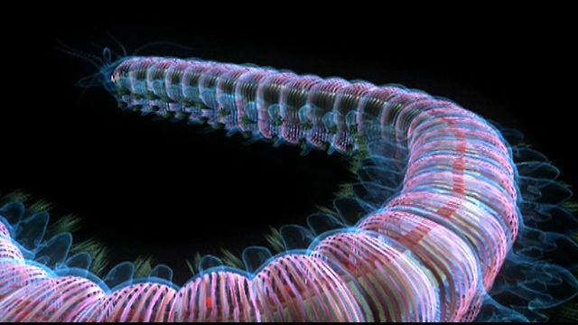
Annelid Body Plan
Watch this video
What complex body features do annelids have that they share with us?
What are the advantages of having a segmented body?

Slide 5
Feeding
What are some ways annelids eat?
What food resource did the first annelids exploit?

Slide 6
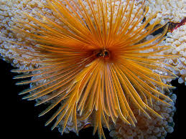
Sabellids-Feather Duster Worms
How does the feather duster worm feed?
What adaptation does the feather duster worm have to avoid danger?

Slide 7
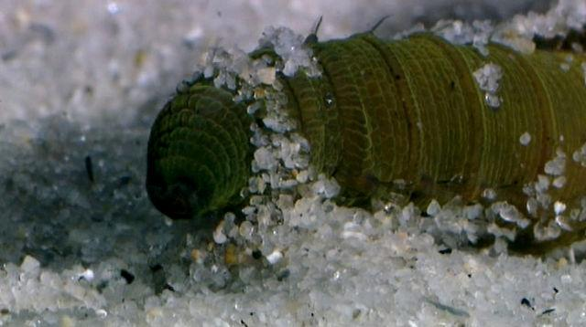
Abarenicola-Lugworm
Watch this video
What do Abarenicola gills do?
How does Abarenicola burrow?

Slide 8
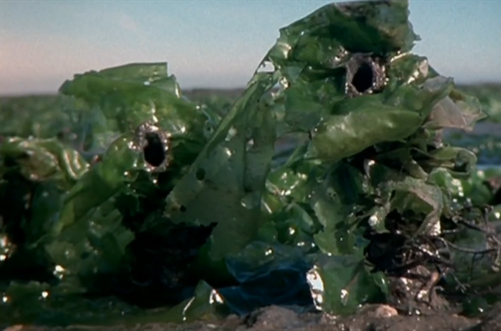
Diopatra-Tube-dwelling Worms
How do tube-dwelling worms in a mudflat help the habitat?
How does Diopatra feed?

Slide 9
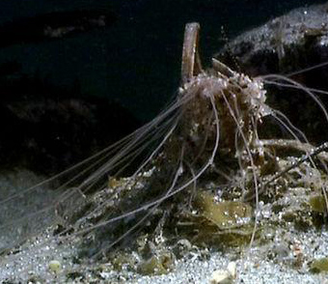
Terrebellids-Spaghetti Worms
How do spaghetti worms feed?
What are their tubes made of?
How do they get oxygen?

Slide 10
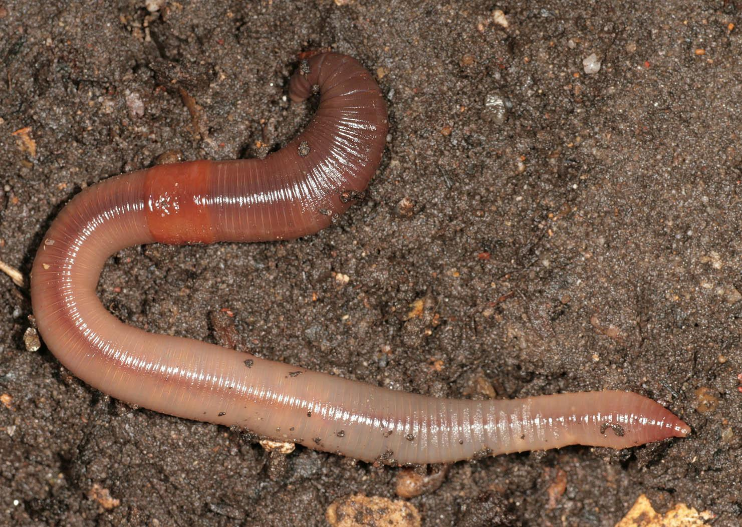
Earthworms
Watch this video
How do earthworms benefit the environment?
How do earthworms move and how are the body segments involved in this action?

Slide 11
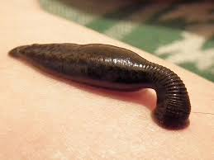
Leeches
Watch this video
What adaptations do leeches have for sucking blood?

Slide 12
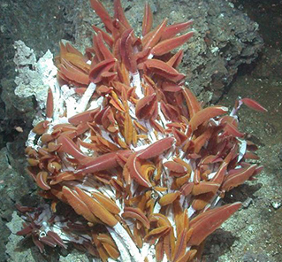
Hot Vent Worms
What lives in their gills that provides nutrients?
Where do hot vent worms live?

Slide 13
Annelid Adaptations
Name three different annelid worms and explain how they are adapted to live where they do.

Slide 14
Vocabulary
Define in your own words these vocabulary words at the end of the video.
Segmentation Noxious
Gills Hot vent
Sediment Anesthetic

