Slide 1
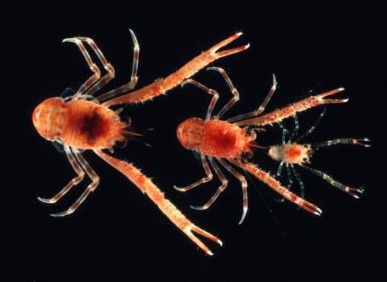
Marine
Arthropods: A
Successful
Design

Slide 2
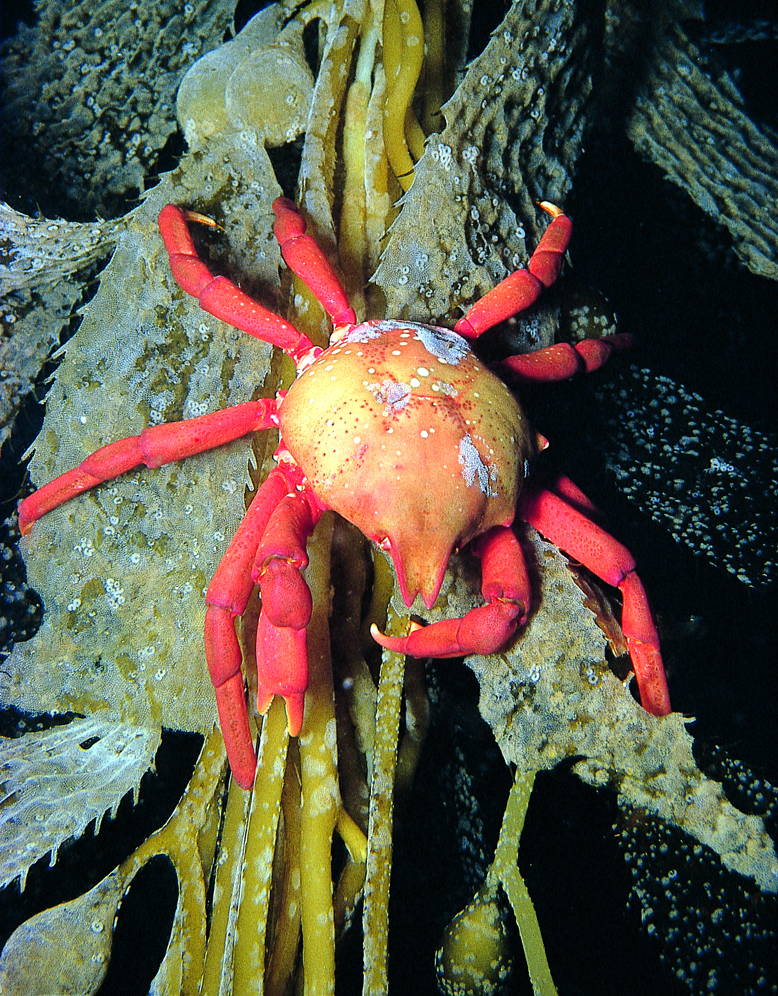
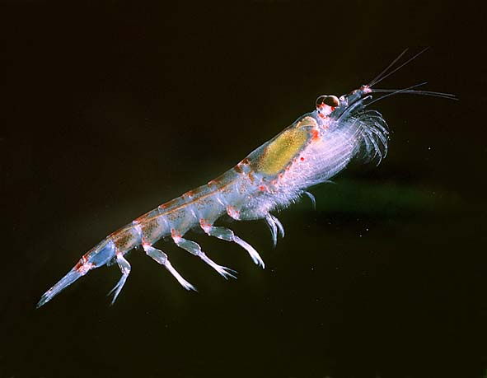
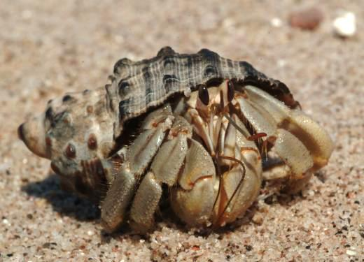
These Are Marine Arthropods

Slide 3
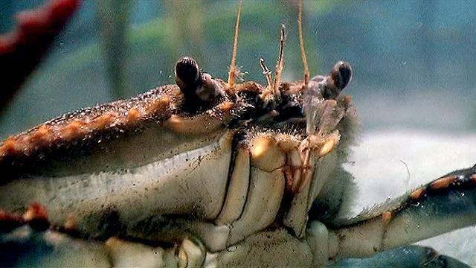
Watch Marine Arthropods: A Successful Design. Take Notes And Answer the Following Questions.
Watch this video.

Slide 4
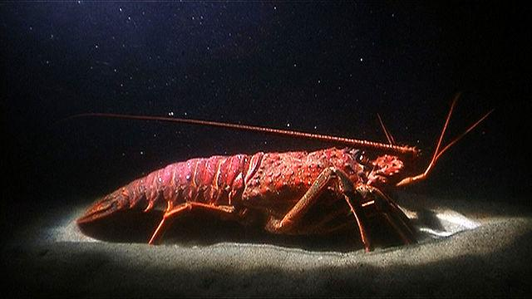
Appendages
What is special about arthropod
appendages?
What are the advantages of this type of
appendage?
List the different uses of arthropod
appendages.

Slide 5
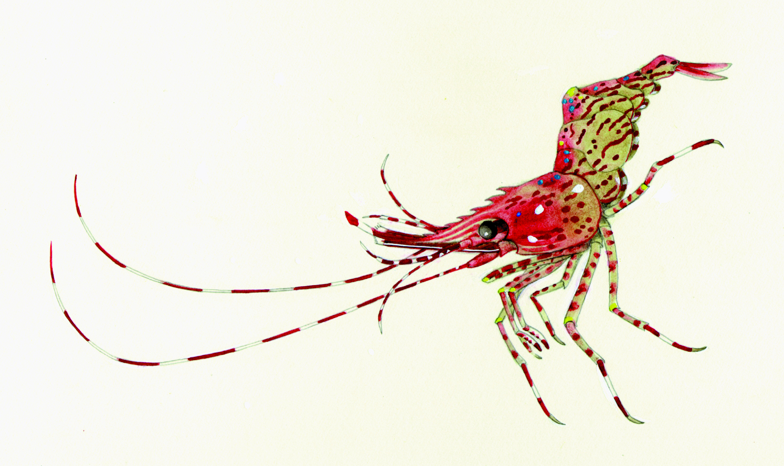
Sensing the World
What senses do the animals in the episode have?

Slide 6
Exoskeleton
How did the Arthropod exoskeleton help them dominate the ocean?
What are the advantages and disadvantages of having an internal skeleton like ours as opposed to an external skeleton that is shed to grow?

Slide 7
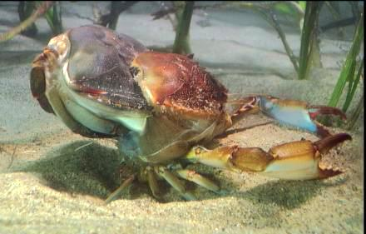
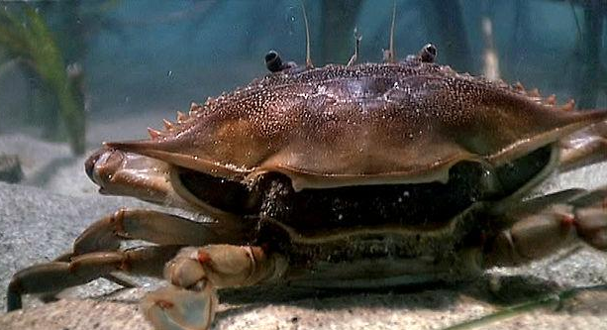
Molting
Watch this video.
Briefly describe how a crab molts.
About how long does it take the new shell to completely harden?

Slide 8
Breathing
What arthropod structures are used to extract oxygen from water?
Which other animals use similar structures to extract oxygen?

Slide 9
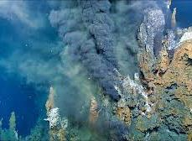
Habitats
Name one Arthropod that has thrived in cold marine waters.
Name one that has thrived in extremely hot marine waters.

Slide 10
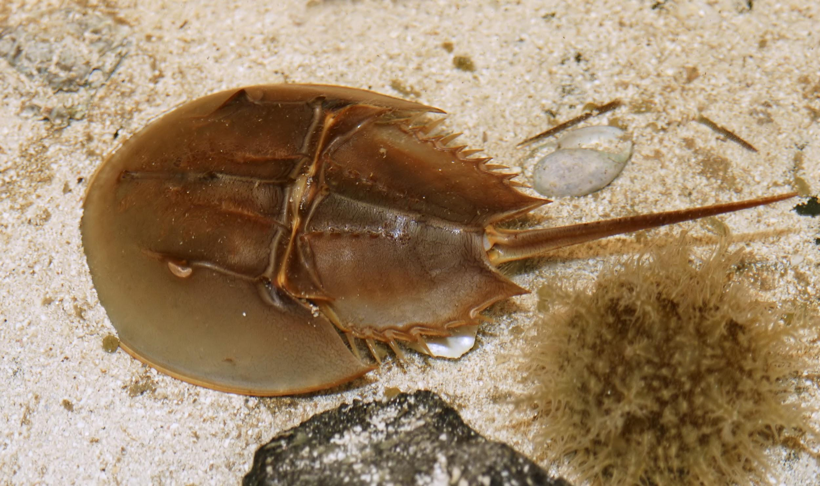
Horseshoe Crab
Watch this video.
What clues do horseshoe crabs give us about about why arthropods came onto land?

Slide 11
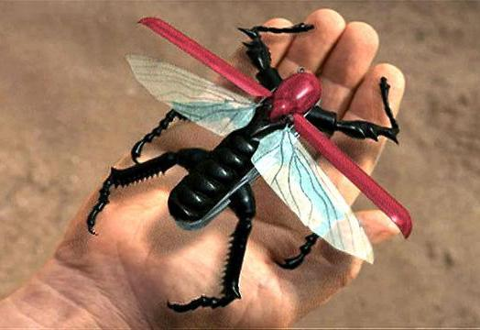
A Successful Design
Watch this video.
How did Arthropods succeed
In the arms race?
How is a Swiss Army knife a good metaphor for the arthropod?

Slide 12
Vocabulary
Define in your own words these vocabulary words at the end of the video.
Appendage Molting
Antenna Diversifying
Exoskeleton Gill
Segmentation Hydrothermal vent

